Slide 1
Investigating the role of PD-L1 pathway in
preventing UV induced squamous cell carcinoma
Presented by
Yao Zhan
June 18th, 2019

Slide 2
Background
Immunosuppressed patients have high incidence of squamous cell carcinoma
Vitiligo patients have decreased incidence of squamous cell carcinoma
3. Previous work from our lab has found:
) MITF directly regulates PD-L1 mRNA expression
silencing of MITF in primary melanocytes decreases PD-L1 mRNA level;
constitutively expressing MITF increases PD-L1 mRNA expression
2. ) MITF directly binds to the promoter of PD-L1 gene and its upstream
enhancer
3. ) Basal levels of PD-L1 RNA is significantly lower in Mitf^{wh/wh} skin
Hypothesis: PD-L1 (from melanocytes) contributes to prevent
UV-induced precancerous SCC cells from destroyed by immune clearance

Slide 3
Potential research interests
1. Skin is stratified into sub layers in epidermal compartment
Basal layer – intermediate differentiated layers – terminal differentiated layers
2. Basal layer of epidermal cells retain low differentiation/high proliferative properties,
Whereas terminal differentiated cells have low potential to proliferate and will eventually
peel off regularly
3. We hypothesis high UV signature mutation will be enriched in basal layer
cells VS upper layer cells, due to high potential of integrating pyrimidine dimers
into the genome during DNA replication in these cells.
4. If the above hypothesis is true, we would be able to test clonal expansion :
a column of basal – intermediate diff – terminal diff cells may share the same
mutations since they all originate from the same basal cells.
5. expression profiling + mutation profiling analysis would enable us to tell/compare the mutation frequency in specific cell type (melanocytes, keratinocytes, Immune cells …)
6. Identify the expression signatures in each skin layer of mouse biopsies.

Slide 4

Three animal models using in this project
XPC^{-/-}
MC1R^{e/e}
examining the efficacy of anti-PD1 on
diminishing UV induced SCC tumors in both models
2. examining whether the presence of melanocytes
impacts the incidence of UV induced SCC
1.
2.
XPC^{-/-}
MC1R^{e/e}
K14SCF
examining whether PD-L1 pathway prevents
UV induced SCC from immune clearance
3.
XPC^{-/-}
MC1R^{e/e}
K14SCF
PD-L1-/-

Slide 5
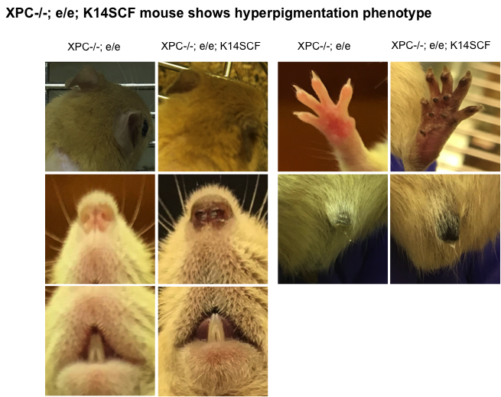

Slide 6
Experiment cohort 1 : XPC -/- ; mc1r e/e
Treatment: 150mJ/cm² UVB
Goal: Identifying the suitable dosage/timeframe of developing UV induced SCCs
Experiment cohort 2 : XPC -/- ; mc1r e/e
Treatment: 150mJ/cm² UVB
Goal: Investigating the efficacy of anti-PD1 in UV induced SCCs
Experiment overview
Experiment cohort 3,4 : XPC -/- ; mc1r e/e ; (K14SCF)
Treatment: 150mJ/cm² UVB + IgG/anti-PD1
Goal: Investigating the efficacy of anti-PD1 in UV induced SCCs
Experiment cohort 5 : XPC -/- ; mc1r ; K14SCF; PDL1-/-
Treatment: 150mJ/cm² UVB + IgG/anti-PD1
Goal: Investigating the efficacy of anti-PD1 in UV induced SCCs

Slide 7
UV irradiation induced SCC incidence in XPC-/-, e/e
mouse models
Overview of the cohort 1,2 experimental cages
XPC-/-; e/e
X19
wk1 wk2 wk3 wk4 wk5 wk6 wk7 wk8 wk9 wk10 wk11 wk12 wk13 wk14 wk15 wk16 wk17 wk18 wk19 wk20 wk21 wk22
UVB: 150mJ.cm⁻² ; 5/4 times/week
UVB: 150mJ.cm⁻² ; 5/4 times/week

Slide 9
n = 33
n = 33

Slide 10
(n = 19)
(n = 19)

Slide 11
Investigating the effect of immune check point inhibitor
anti-PD1 on preventing UV irradiation induced SCC in
XPC-/-, e/e mouse models
Overview of the cohort 2,3,4 experimental cages
XPC-/-; e/e; (K14SCF) IgG VS anti-PD-1
X13
wk1 wk2 wk3 wk4 wk5 wk6 wk7 wk8 wk9 wk10 wk11 wk12 wk13 wk14 wk15 wk16 wk17 wk18 wk19 wk20 wk21 wk22
anti-PD1/IgG
x3 200ug/mouse
anti-PD1/IgG
x3 200ug/mouse
UVB: 150mJ.cm⁻² ; 4 times/week
UVB: 150mJ.cm⁻² ; 4 times/week

Slide 16
Logan

Slide 17
Logan

